Slide 1
Knowledge Clip
Embedded Systems
pthread
brojz@hr.nl

Slide 2
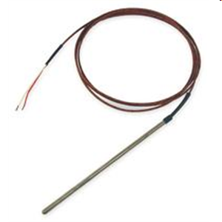

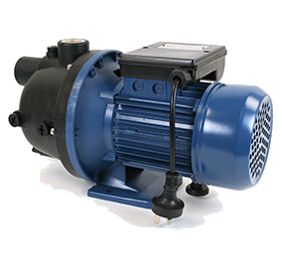
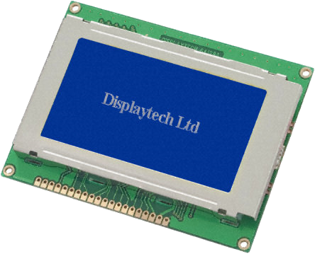

Example Embedded System
thermocouple
pressure transducer
ADC
ADC
T
P
S
DAC
Switch
Screen
pump/valve
heater

Slide 3


POSIX
POSIX
Portable Operating System Interface (POSIX) is a standard API for Operating Systems.
  Many OS partially comply with this standard. For example: Linux, Android, OSX, VxWorks, QNX Neutrino, TI-RTOS etc.
Tasks (threads) are dynamically created by using API calls.

Slide 4
Pthread Example (1 of 2)
void *print1(void *par) {
for (int i = 0; i < 10; i++) {
usleep(100000);
printf("print1\n");
}
return NULL;
}
void *print2(void *par) {
for (int i = 0; i < 10; i++) {
usleep(200000);
printf("print2\n");
}
return NULL;
}

Slide 5
Pthread Example (2 of 2)
void *main_thread(void *arg) {
pthread_attr_t pta;
pthread_attr_init(&pta);
pthread_attr_setstacksize(&pta, 1024);
pthread_t t1, t2;
pthread_create(&t1, &pta, &print1, NULL);
pthread_create(&t2, &pta, &print2, NULL);
pthread_join(t1, NULL);
pthread_join(t2, NULL);
check( pthread_attr_destroy(&pta) );
return NULL;
}
Source: pthread.c

