Slide 1
Knowledge Clip
Embedded Systems
pthread
semaphore
brojz@hr.nl

Slide 2
Mutex
Simple way to create a mutual exclusive so called critical section.
Only one task can be in the critical section.
Mutex has a lock (take) and a unlock (give) function.
OS ensures that these functions are atomic!
At the start of the critical section the mutex must be locked (taken) and at the end of the critical section the mutex must be unlocked (given).

Slide 3
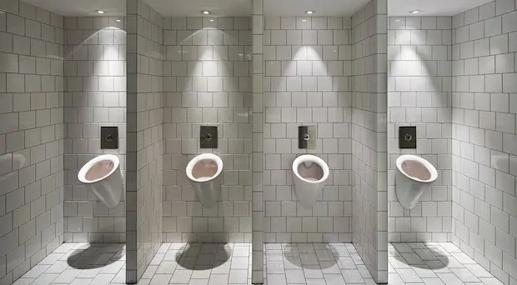
Manage resources when more resources are available
Four men can enter, fifth one must wait until someone leaves.

Slide 4
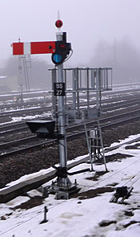
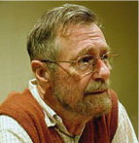
Counting Semaphore
Operations:
Psem (prolaag (probeer te verlagen), take, wait): wait (block, sleep) if count == 0 else decrement count.
Vsem (verhoog, signal, give, post): unblock a waiting task if count == 0 else increment count.
Order of unblocking (wake up):
general purpose: FIFO
real-time: highest priority
Edsger Dijkstra

Slide 5
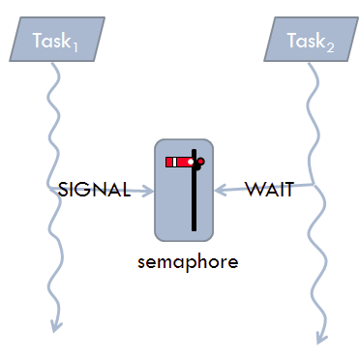
Semaphore versus Mutex
Mutex can only be used for mutual exclusion (task which takes the mutex should also give the mutex (back)).
Semaphore can also be used for other synchronization purposes.
post
wait

